Slide 1



MongoDB_FARMEX
FS’tival-22 Software Freedom Day
TEAM MEMBERS
DHARSANA - 20C019
LOKESH D - 20C049
MADHU PRIYA DHARSHINI S - 20C050
GitHub : https://github.com/LokeshDanapal/FStivel-MongoDB

Slide 2
Problem Statement
To develop a web portal where farmers can post their queries regarding plant diseases, pest management and weed control and receive advice from professionals.
DESCRIPTION:
Agriculture struggles to feed the rapidly growing global population due to increasing plant diseases
It lowers the quality & quantity of food crops.
Prevention can be achieved with adequate technical support.
A community based web portal ,where farmers can upload photographs or describe about the disease affected plants and get instantaneous solutions from experts.
Farmer’s query and expert’s solutions will be stored in the no relational database called MongoDB

Slide 3
Objective
The main goal is to optimize farming processes with the help of technology.
Farmers can upload pictures and deliver their query.
To increase crop productivity by getting help from experts.
To help farmers access through their native language
Through the previously posted queries,farmers may also find matching existing solutions for their current problem.

Slide 4
Tech Stack
BACK-END:
MongoDB – Stores Users Login information, User’s queries and experts answers either in text or image format
Express js – framework based on node js used to build web apps
Node js - fetches and posts user’s request and response ,then posts the response to Database
FRONT-END:
HTML – for structuring front-end Sign in , Sign up , post queries form
CSS - customizing fonts, styles, colors and background for our web portal
JAVASCRIPT – for responsive forms and portals
Notes:
xx

Slide 5


ALTERNATIVES FOR THE TOOL
1.Apache Cassandra
Supports Replication across many data centers and cloud availability zones, created by Facebook for their deployment
Issues - Availability issues ,unpredictable performance
2.Redis
Built-in search capabilities and a linearly scaling high performance and its extremely fast
Issues - Pricing

Slide 6
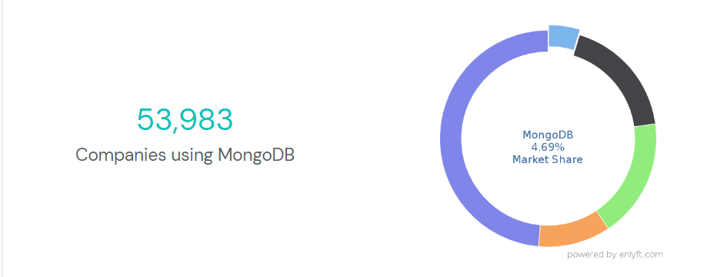
Industries Using Mongo DB
IBM
Twitter
Sony
Zendesk
src:https://enlyft.com/tech/products/mongodb
Notes:
xx

Slide 7
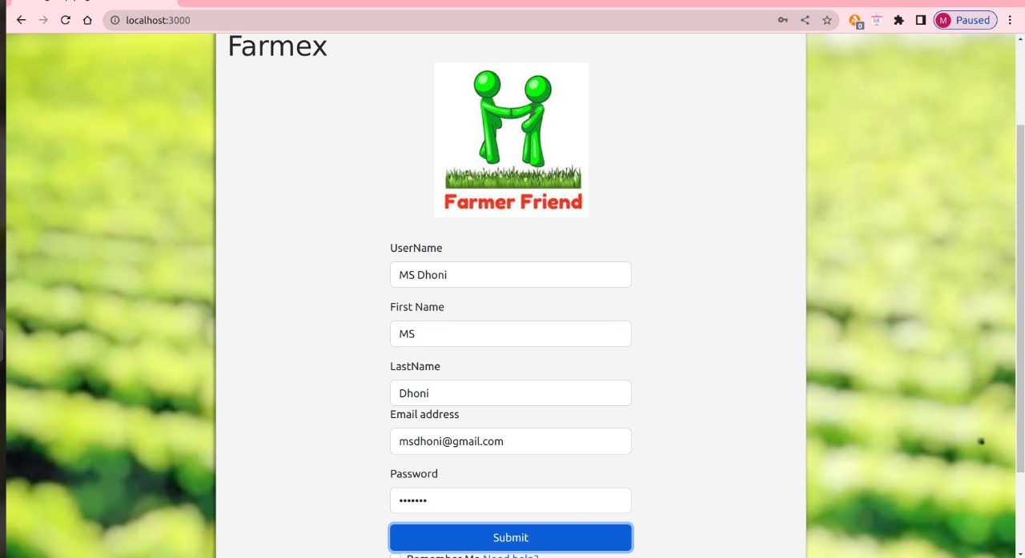
Sign-up page:

Slide 8
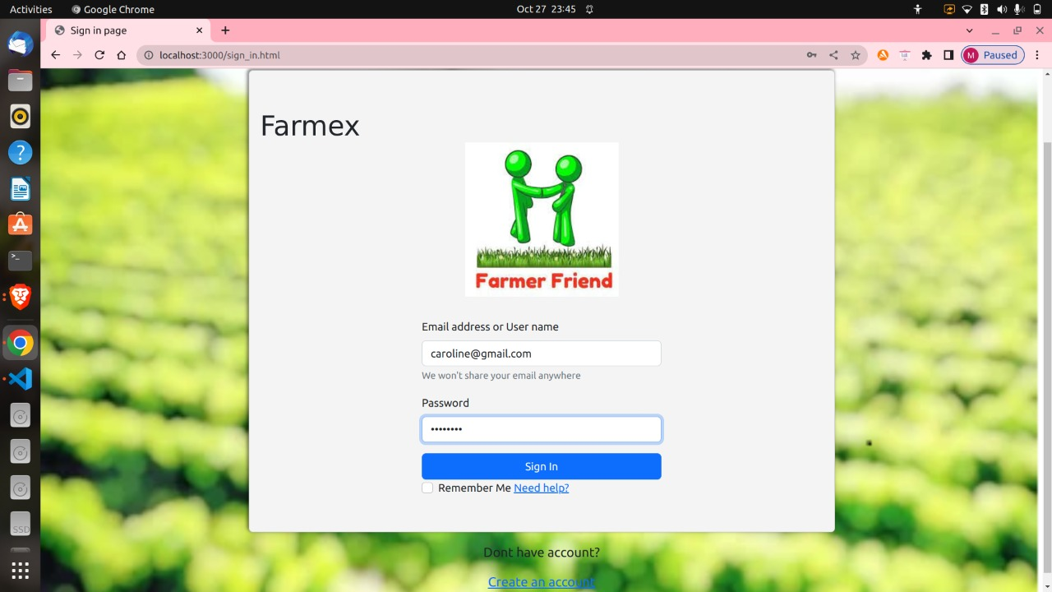
Sign-in page:

Slide 9
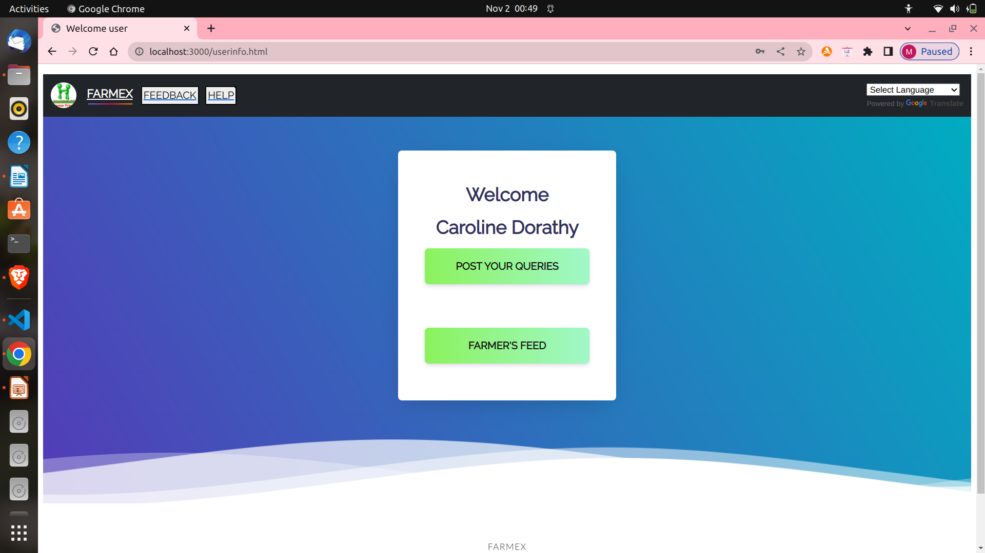
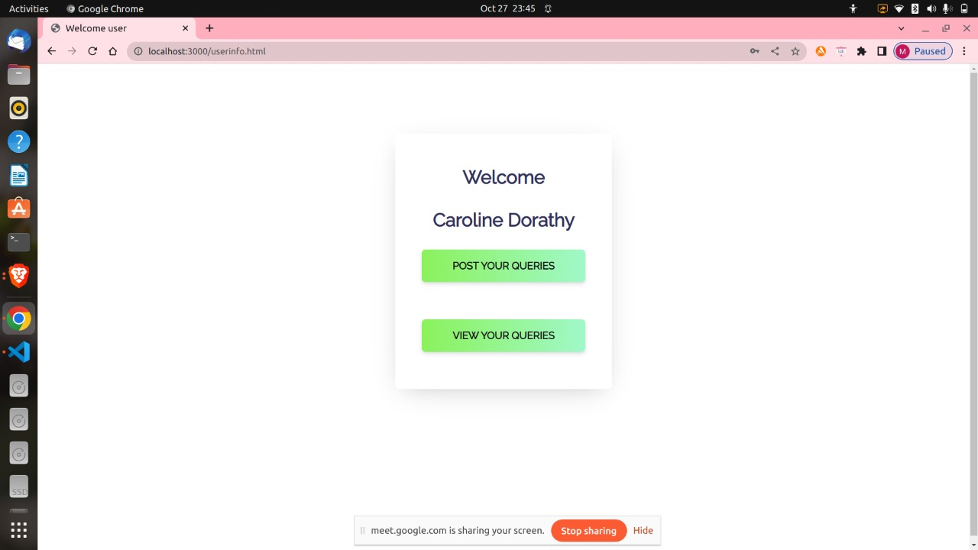
Welcome page

Slide 10
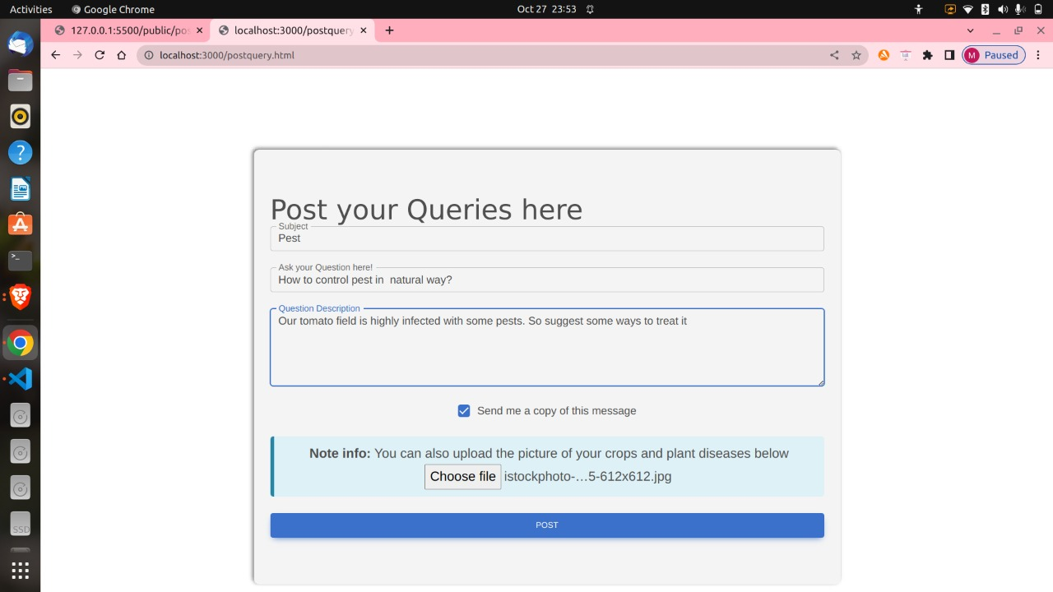
Post your Queries page:

Slide 11
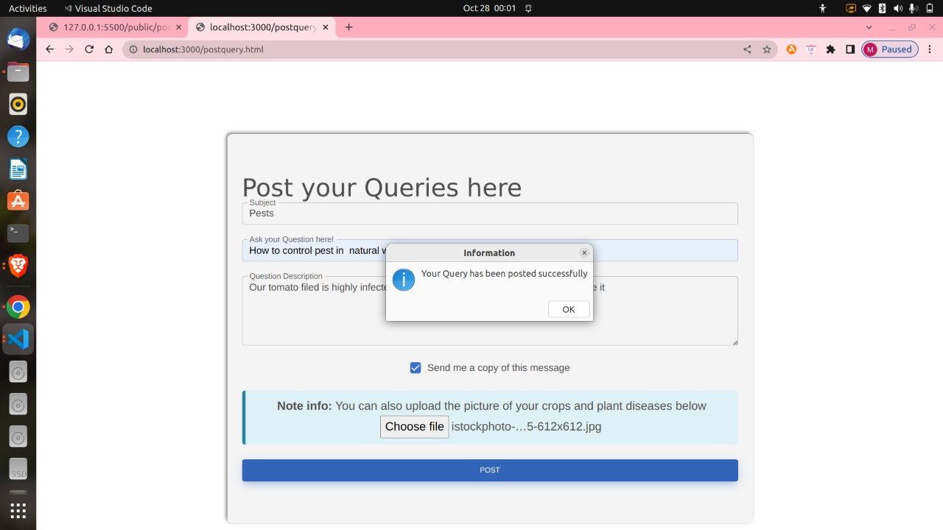
Query posted successfully

Slide 12
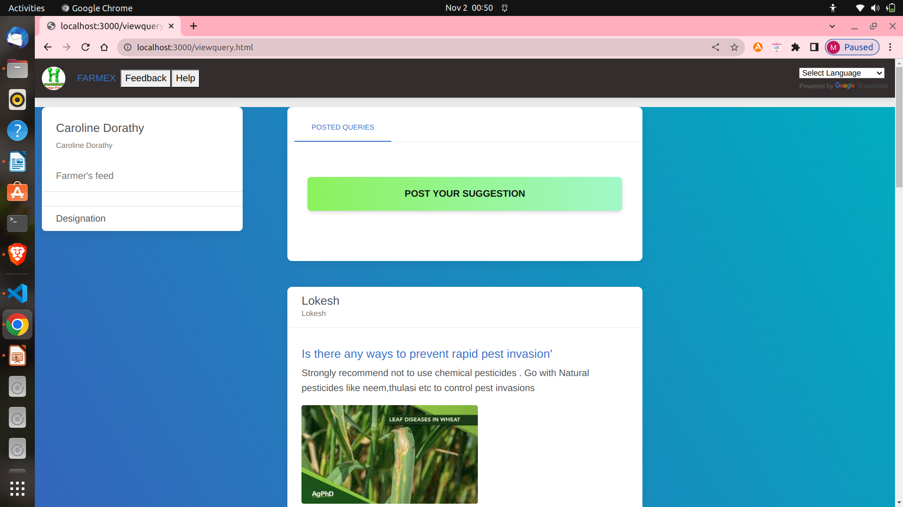
Farmer’s feed page :

Slide 13
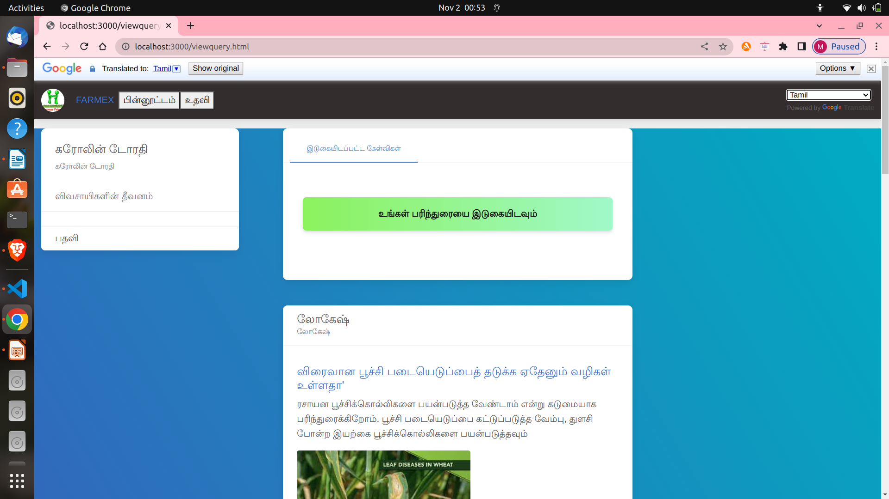
Farmer’s feed – Tamil translation feature

Slide 14
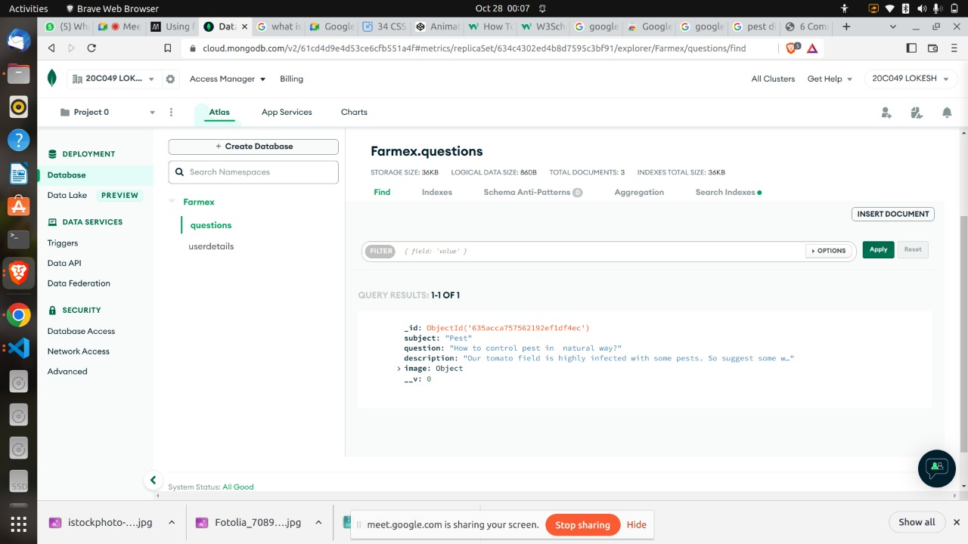
DB collection-questions

Slide 15
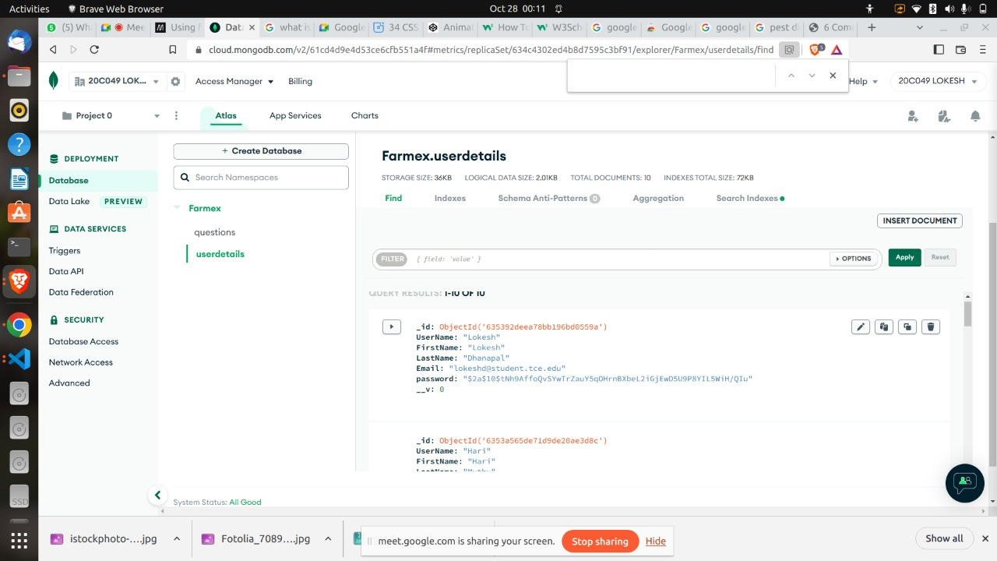
DB collection - UserDetails

Slide 16
Thank You

